Slide 1
Work Report
An automated form building application based on domain-driven-design
DZ20330005 陈哲霏

Slide 2
What is Domain-Driven-Design
- Domain-driven-design (DDD) is the concept that the structure and language of software code (class names, class methods, class variables) should match the business domain. For example, if a software processes loan applications, it might have classes such as LoanApplication and Customer, and methods such as AcceptOffer and Withdraw.
- What does Domain mean here?
It is a rigorously organized and selective abstraction of that knowledge.
- Domain-Driven
Build project based on the comprehensive understand of Domain models.
Reference:
《Domain-Driven Design - Tackling Complexity in the Heart of Software》—— Eric Evans 2003

Slide 3
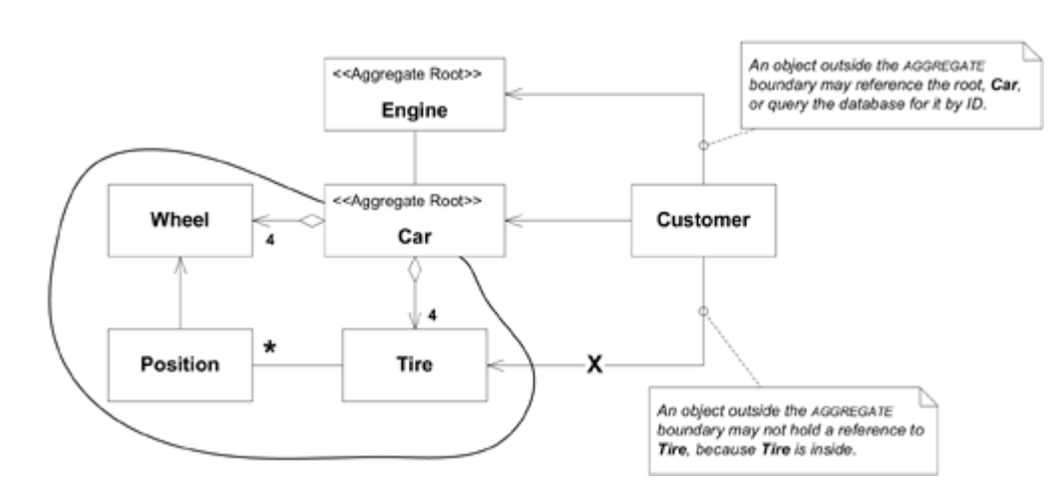
Take Aggregation as an Example
A car assembly line
Wheel、Tire connected by Positon form up an Aggregation, which can be accessed by Car only.
- Using DDD aims at
1. Placing the project's primary focus on the core domain and domain logic;
2. Basing complex designs on a model of the domain;
3. Initiating a creative collaboration between technical and domain experts to iteratively refine a conceptual model that addresses particular domain problems.

Slide 4
Automated Form Building APP
A project developed based on DDD.
- What are the project consists of ?
- How it applies DDD ?
- What are the merits of using DDD in this project ?

Slide 5
What it consists of
Front End
Domain Object Model
Model Parsing/Form Rendering
View
Back End
Data Access Controller
Domain Object Model
Authority
Data Output
DataBase
Usually Plenty of Work

Slide 6
How it applies DDD
- Two main part of Domain Model: Data Model & ProcessInstance Model
- Data Model:
Use a Special DSL(Domain Specific Language) to define Domain object
Which means we need to construct a framework based on this DSL(mainly on how to parse it)
Unstructured Data Storation
Which means we define&modify a domain object at front end unconventionally and store them in a general way without a structure constraint
- ProcessInstance Model:
Define a ProcessInstance for each Data Model to describe their behavior and related features.

Slide 7
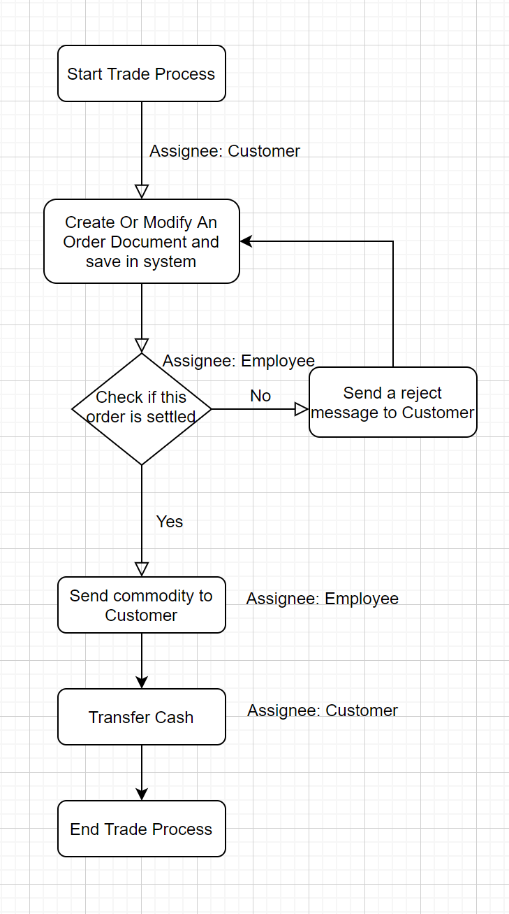
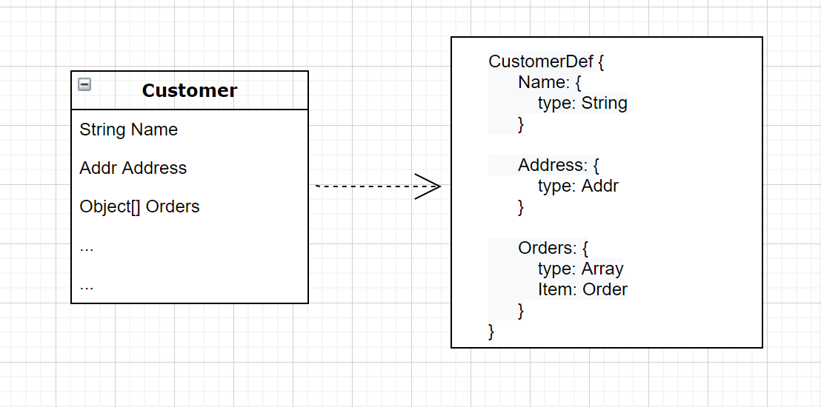
Example of Model
A situation where we need to construct different types of documents.
Example: store a list of customers and employees & build a business model of the trade between customer and company
Data Model: Customer & Employee
Decide the Data Structure
(Typically use Json Schema)
ProcessInstance Model: Trade
Decide the Behavior of Data
(such as BPMN)

Slide 8
When we develop...
Front End
Back End
Domain Object Model Definition Using DSL
Domain Object Definitions are sent to BackEnd to be stored
Save Domain Object in a General Type, eg.document
When the requirements changed, we change the Domain Object Definition Only instead of change the whole system
Paser & Render Specially Designed
Authority、DataBase Specially Designed for the General Type
Data Stored in database are accessable by FrontEnd to be presented
The View Presented to User
Data Output(in the format of the DSL)

Slide 9
Compared with the former framework
Front End
Back End
Domain Object Definitions are defined in backend and accessable by frontend
Get Domain Object Data from BackEnd
Define Domain Object in different types & store them
When the requirements changed, we change the Domain Object Definition、the whole data processing in backend、 the model parsing & rendering in frontend
Paser & Render designed for different types
Authority、DataBase designed according to types of Domain Objects
Data Stored in database are accessable by FrontEnd to be presented
The View Presented to User
Data Output

Slide 10
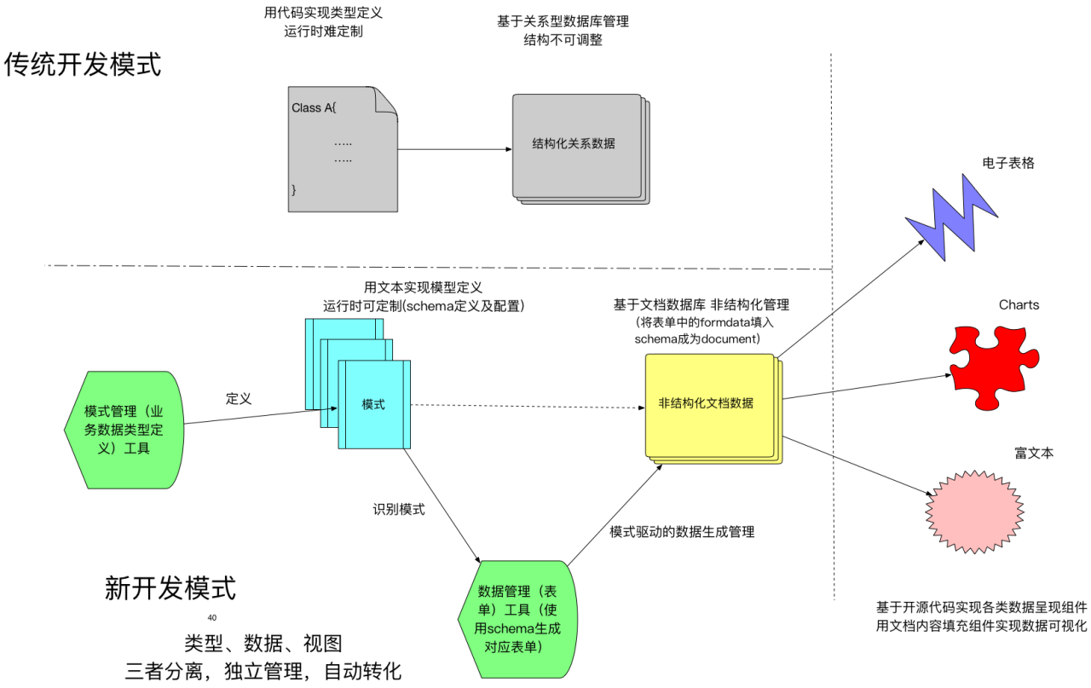
What are the merits
Clearly we find the benefits
- more flexibility
- less cost when changes to Domain model are made
- allow for many add-ons

Slide 11
Conclusion
- Applying Domain-Driven-Design helps us build project in a more systematical way, typically in this project domain model consists of data model and processInstance model, severally describes the data and behavior of a concrete type in practice.
- Using Json Schema(as a DSL) in this project dramatically improves the ease mantainance and flexibility of the whole system.
- The cost comes with the change of requirement is reduced by storing all the documents in a general type and processing them within a specifically designed access controll system.
Next step is to complete a specifically-designed DSL(Json Schema still has its drawbacks), and combine the front end and back end into a whole framework for building a DDD project.

Slide 12
Thanks for listening!

